Slide 1

The rheumatology knowledge transfer contest
A new eular | EMEUNET initiative

Slide 2
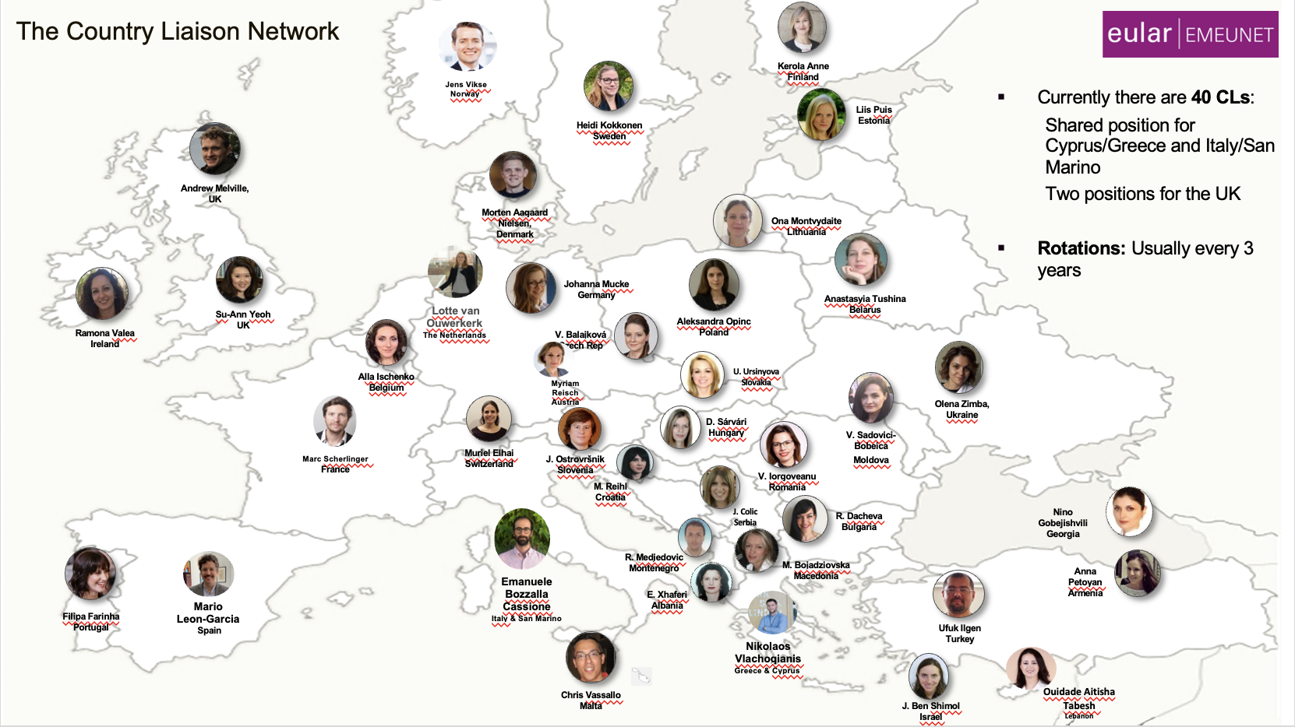


RheumaVision – the rheumatology knowledge transfer contest
Round 1: national selections
Round 2: “semi finals”
Round 3: live finals!
1 video from each EULAR membership country
6 finalists present extended 7 min talks
Country contribution selected by the EMEUNET CL in each country
6 finalists selected by EULAR Congress Committee jury
1 winner based on EULAR live panel jury and audience voting

Slide 3
How can you participate?
Eligibility:
Video Requirements:
Length: 3-5 minutes
Topic: Choose a core topic in rheumatology (e.g., RA, SpA, SSc, imaging, precision medicine).
Suggested Topics:
Guideline Overviews: Highlight recent updates from EULAR/ACR on key conditions.
Diagnostic Innovations: Discuss new diagnostic tools, biomarkers, or methods.
Autoimmunity Mechanisms: Explain immunological pathways related to disease mechanisms.
Rare Disease Management: Review strategies for managing rare rheumatic conditions.
Patient-Centered Care: Topics like shared decision-making and patient education.
New Treatments: Describe mechanisms and clinical impact of emerging rheumatology drugs.
Open to all EMEUNET members aged 40 or younger.

Slide 4
1 Nov.
Open call
15 Dec.
Submission of applications
(by Dec 15 th)
10 Jan.
National selections by CLs
(by Jan 10th)
30 Jan.
Evaluation by EULAR and EMEUNET Sc
(by January 30th)

Slide 5

How to win (and what)?
Show great communication and presentation skills
Be engaging and inspiring
Submit a creative video
With interesting and accurate content
The 6 finalists receive a full EULAR bursary
  Congress access
  3 nights accommodation
  €350 for travel and living expenses
Notes:
We are interested in how but also in what you present.

Slide 6
Ready to make an impact??!
Submit now your video!
https://eular-it.atlassian.net/helpcenter/emeunet/portal/170/create/10588

